Slide 1

Freelancer System Project

Slide 2


What is The problem !?
Freelancer System
Previous Systems

Slide 3
What we suggest !
Avoid defects
Help The Freelancers

Slide 4
1.
Our Policy
Let’s start with the first setp

Slide 5
How We Can Do That !
Keep rights
Appreciation of tiredness
Strong Portfolio
You can Work , You can Buy , You Can do both .

Slide 6
I am a freelancer .
My services are available to anyone at any time.
Chris Hardwick

Slide 7
Easy to Use

Slide 8
System Analysis
Data flow diagram.
Context level .
Diagram 0 .
Database System
Entity–relationship model
Schema

Slide 9
Tools
For User
Good Browser .
E-mail .
PayPal Account.
For Admin
Good Browser .
E-mail .
Business PayPal Account .
Few knowledge About Programing Languages & SQL .
Domain & Host .
For Developers
HTML5, CSS3, JS.
XAMPP.
Photoshop & Adobe Illustrator .
PHP & MYSQL .
MS Office
Good Knowledge in Version-Control like GitHub

Slide 10



Responsive web design
In 2019 You Need Responsive website .
Use Frameworks To Help you .

Slide 11

Place your screenshot here
Desktop project
Show and explain .

Slide 12

Place your screenshot here
Tablet project
Show and explain .

Slide 13

Place your screenshot here
Phone project
Show and explain .

Slide 14
UI Designer
UX Designer
UI Developer

Slide 16


Slide 17


Slide 18
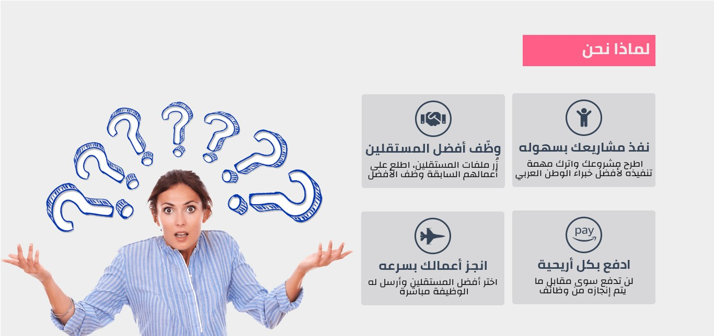

Slide 19
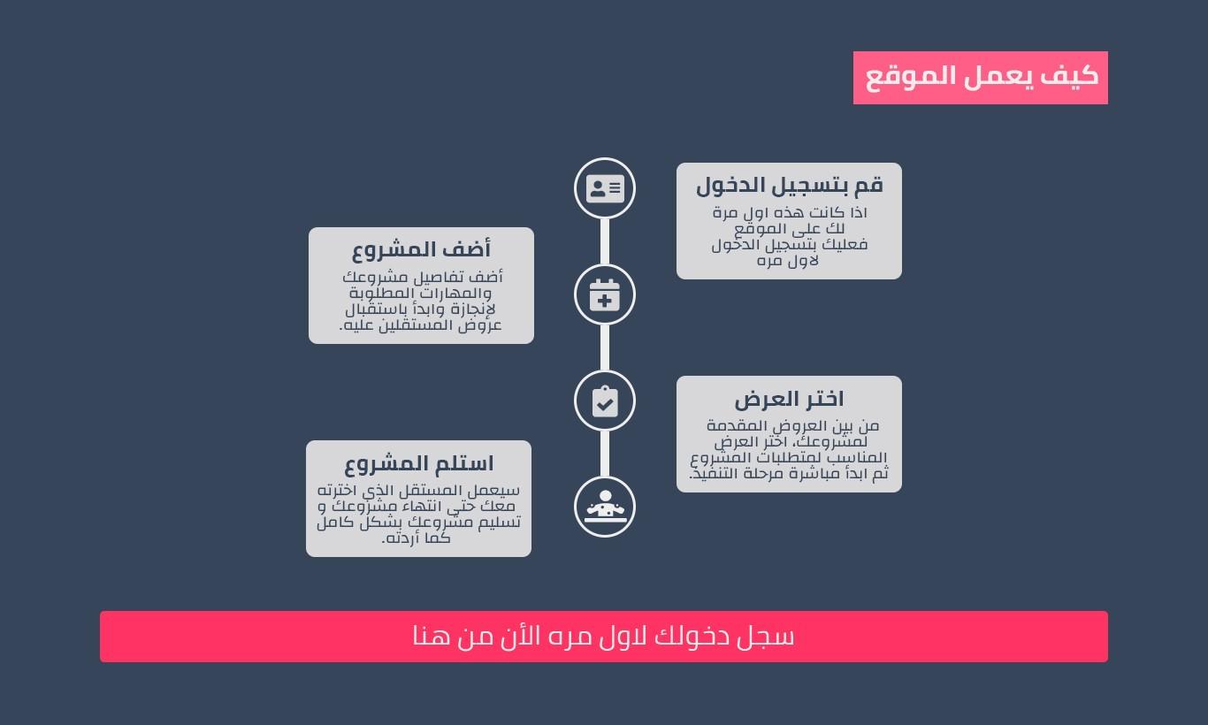

Slide 20
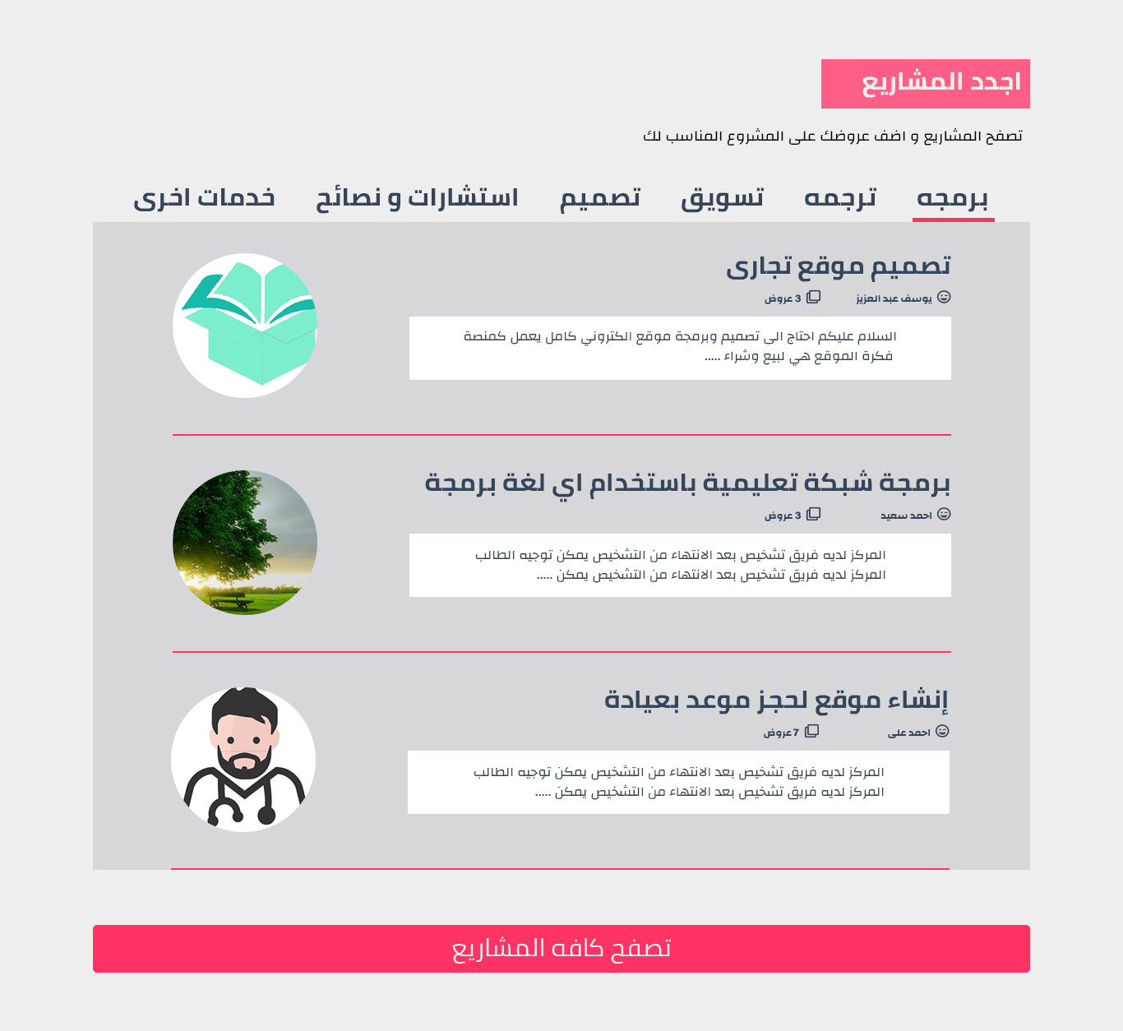

Slide 21
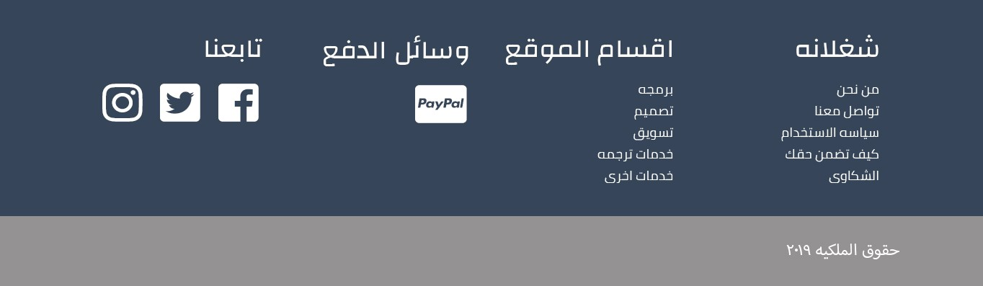

Slide 22
thanks!
Any questions?

Slide 23
Credits
Special thanks to all the people who made and released these awesome resources for free:
Presentation template by SlidesCarnival
Photographs by Unsplash

Slide 24
Presentation design
This presentation uses the following typographies:
Titles: Walter Turncoat
Body copy: Sniglet
You can download the fonts on these pages:
https://www.fontsquirrel.com/fonts/walter-turncoat
https://www.fontsquirrel.com/fonts/sniglet
You don’t need to keep this slide in your presentation. It’s only here to serve you as a design guide if you need to create new slides or download the fonts to edit the presentation in PowerPoint®

